Slide 1

E2 Escape Room - Circuit Maze

Slide 2
Team Member Introductions

Slide 3

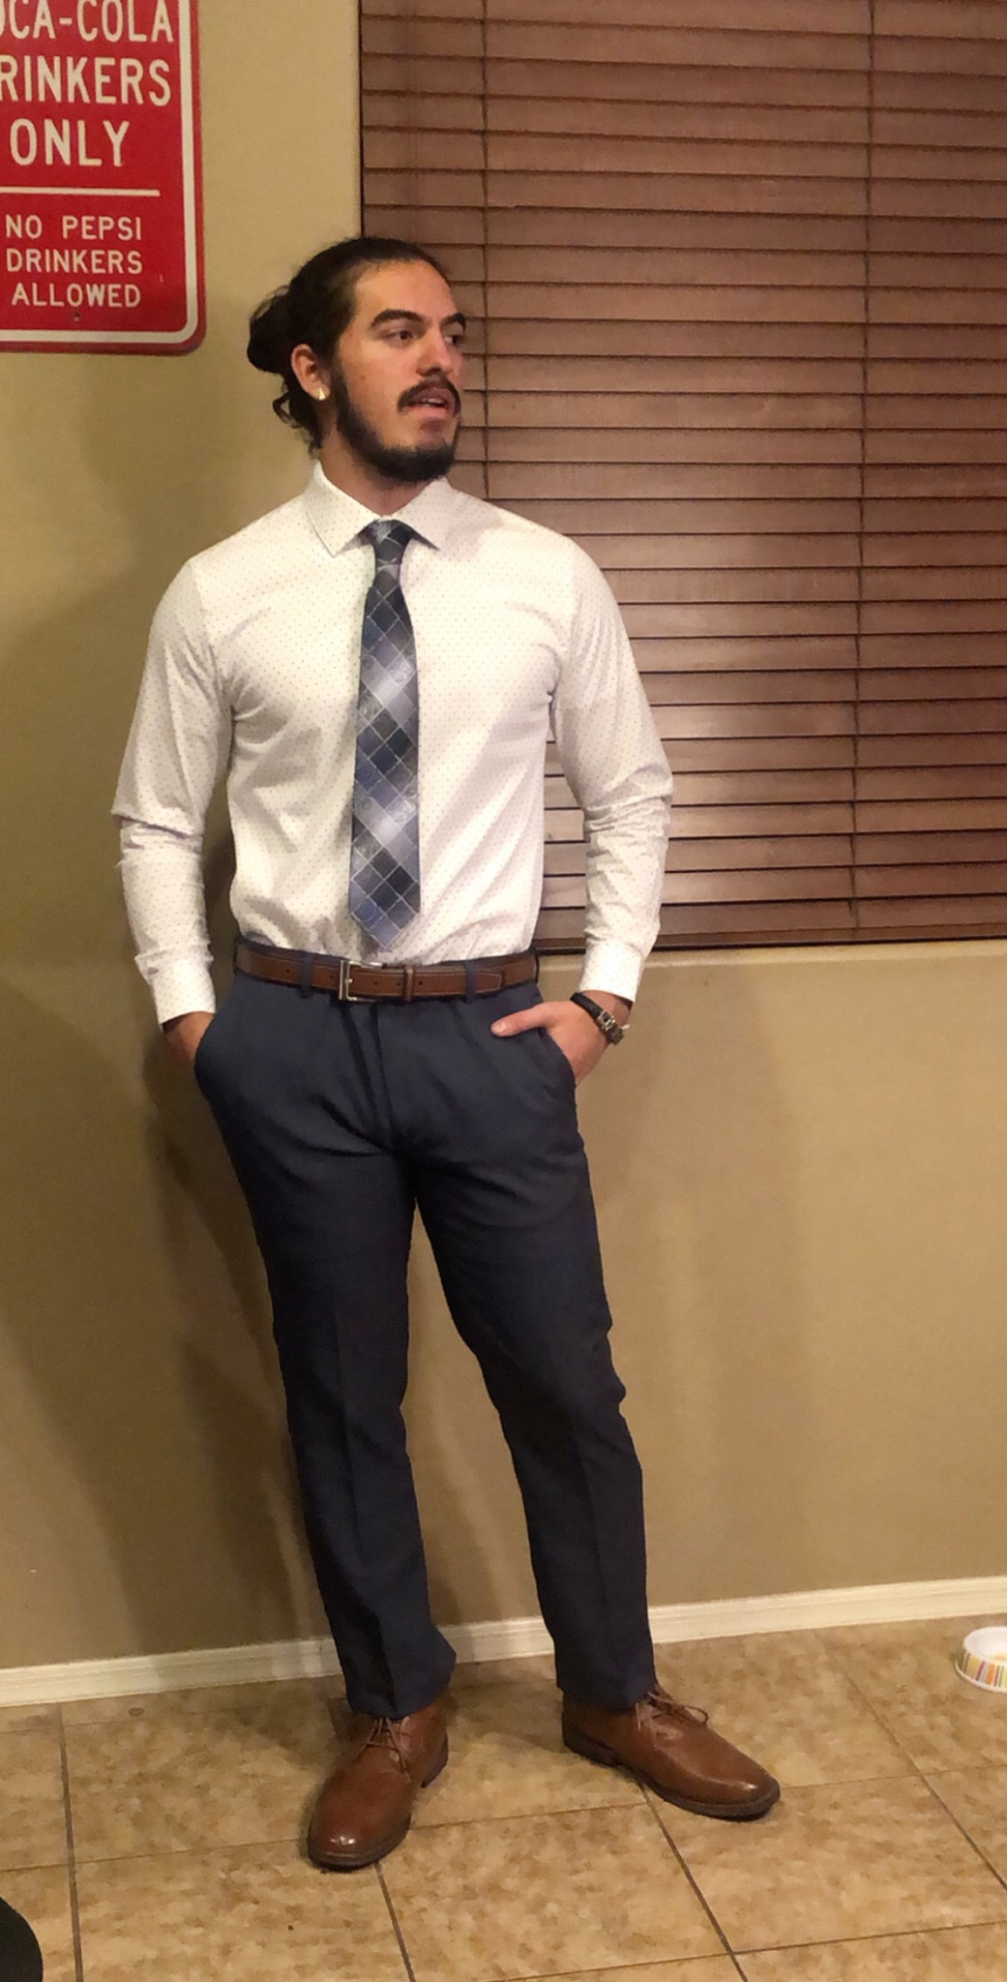
Marquis Ramirez
Sophomore
Major: Electrical Engineering

Slide 4
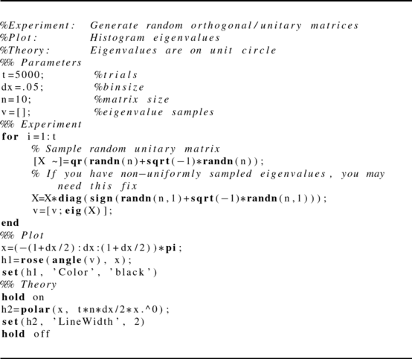

Grace Clark
Sophomore
Major: Computer Science

Slide 5
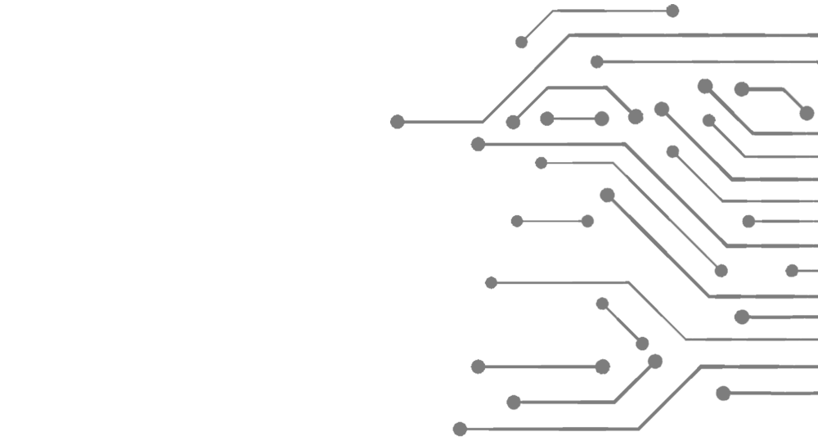

Nafea Alanazi
Junior
Major: Electrical Engineering

Slide 6

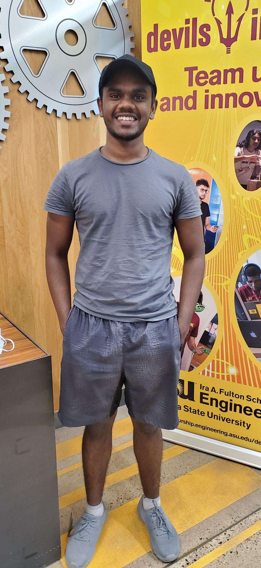
Amal Shifwath Shaik
Freshman
Major : Computer Science

Slide 7

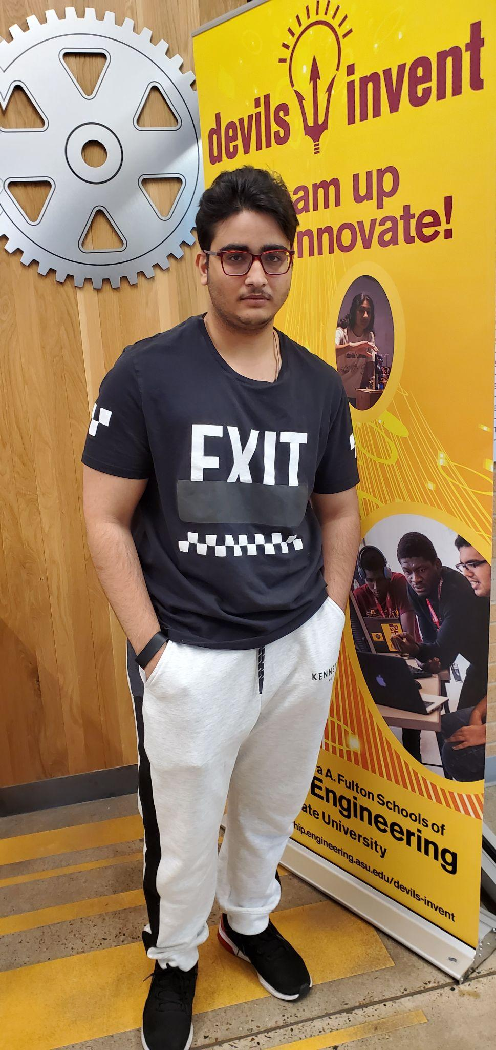
Murtadha AlAsadi
Freshman
Major: Electrical Engineering

Slide 8
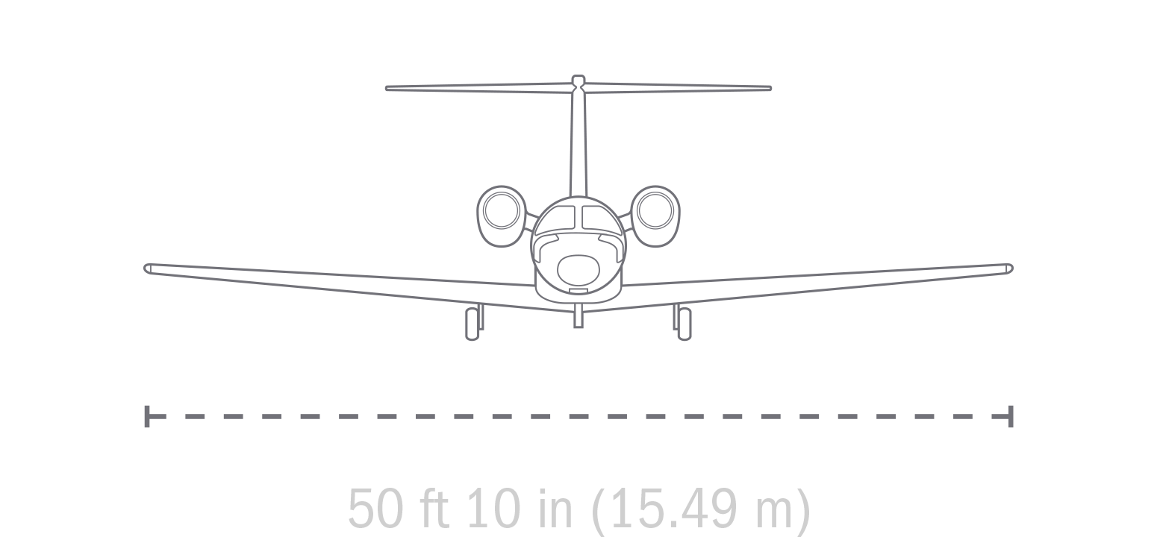
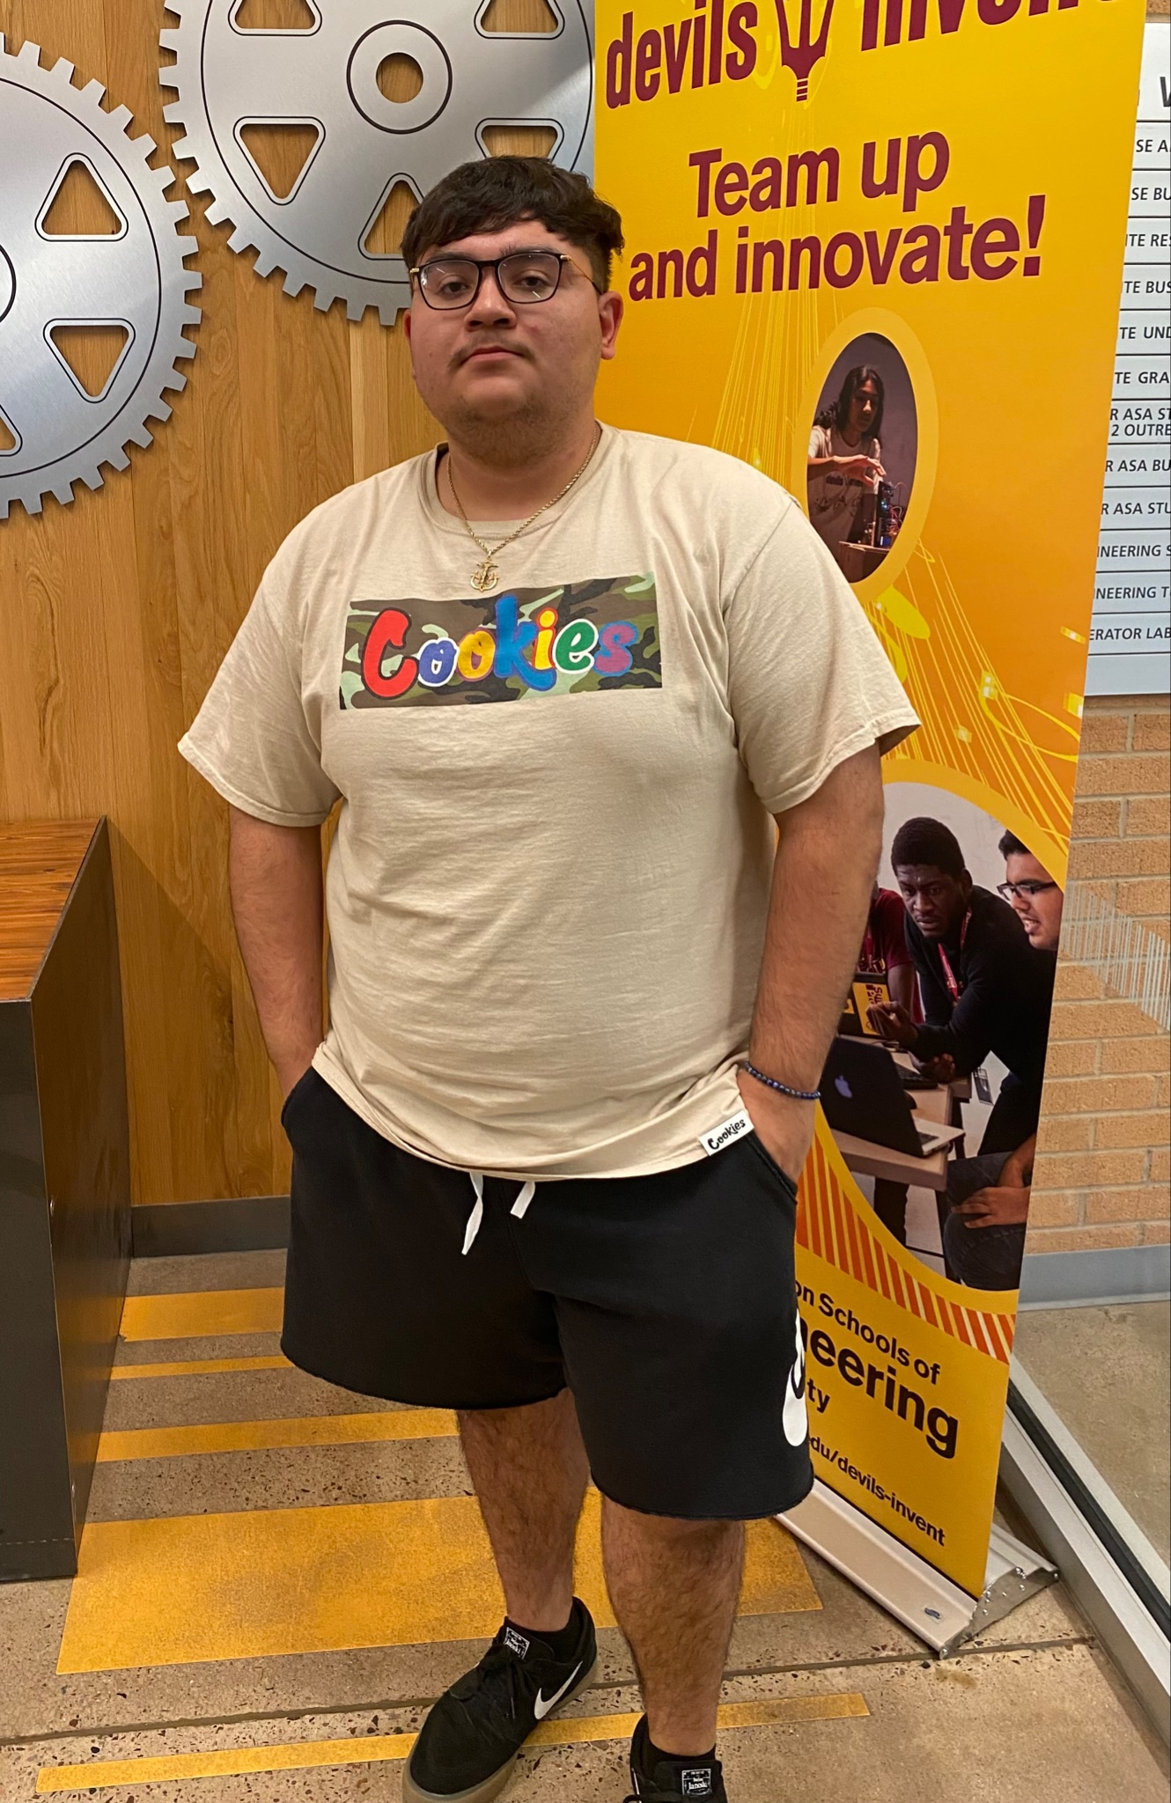
Rodrigo Avilez
Freshman
Major: Aerospace Engineering

Slide 9
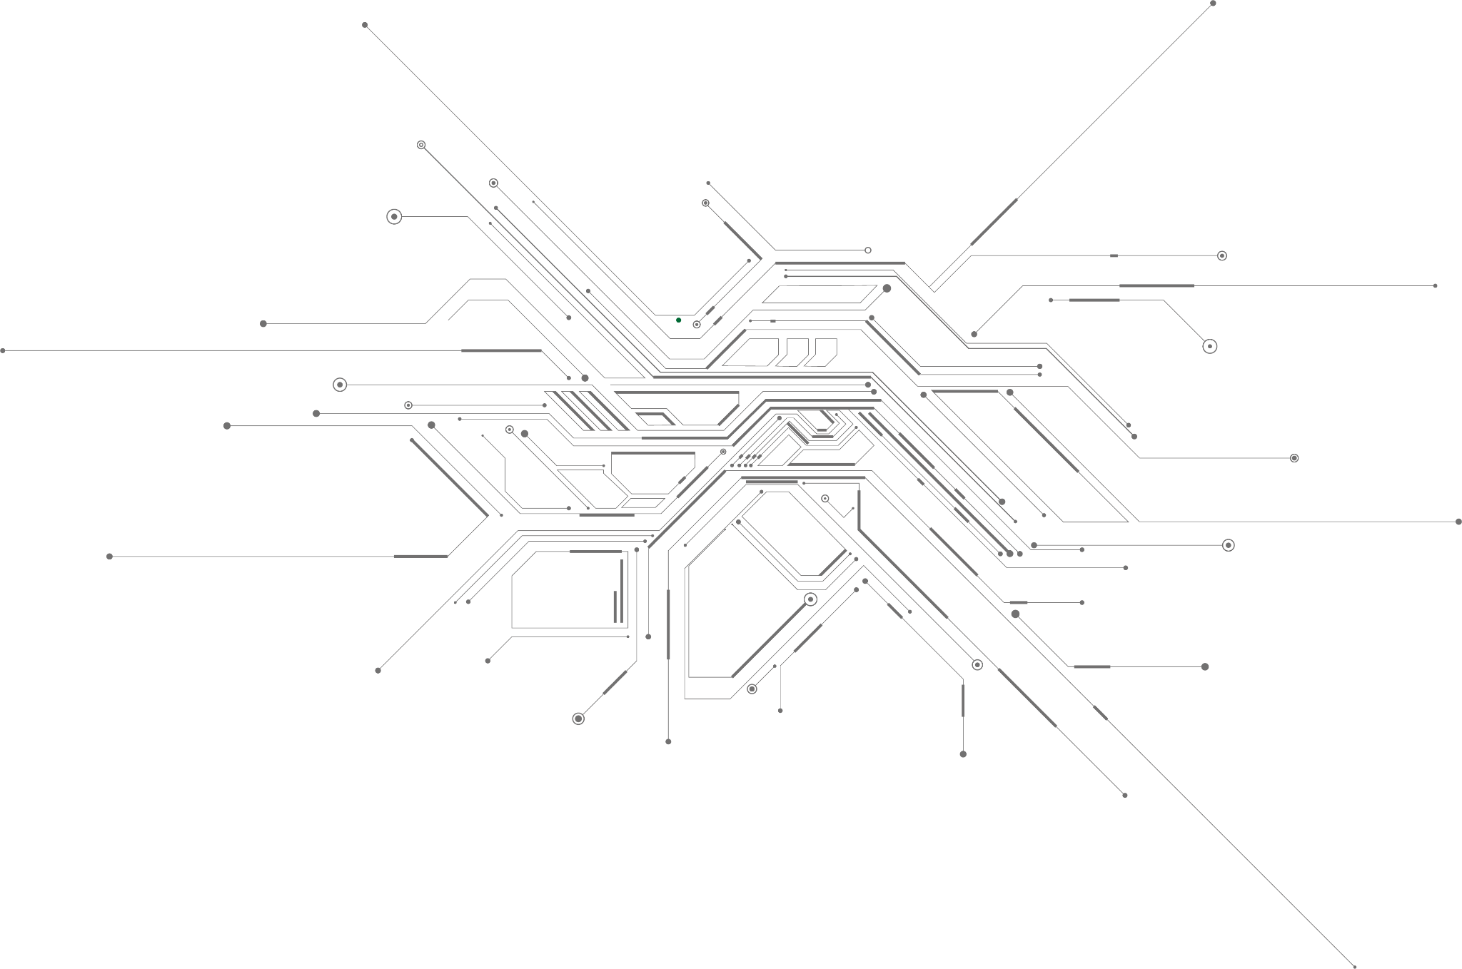
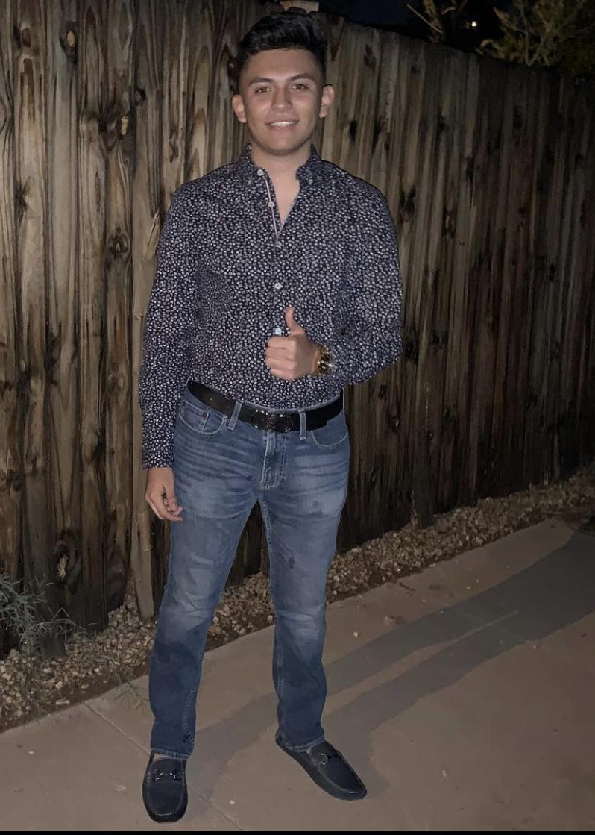
Cesar Vargas
Sophomore
Major: Electrical Engineering

Slide 10
Project Background

Slide 11


Primary Stakeholders
Courtney Langerud: ASU Staff, E2 organizer, Epics coordinator
Jesse Rutzen: Engineering Academic Facilities Specialist, in Logistics/Materials/Construction

Slide 12

Background
E2 is an engineering camp for incoming ASU freshman in engineering that takes place over a few days at Prescott Pines.
For many it is the first time getting to experience engineering as an ASU student.

Slide 13
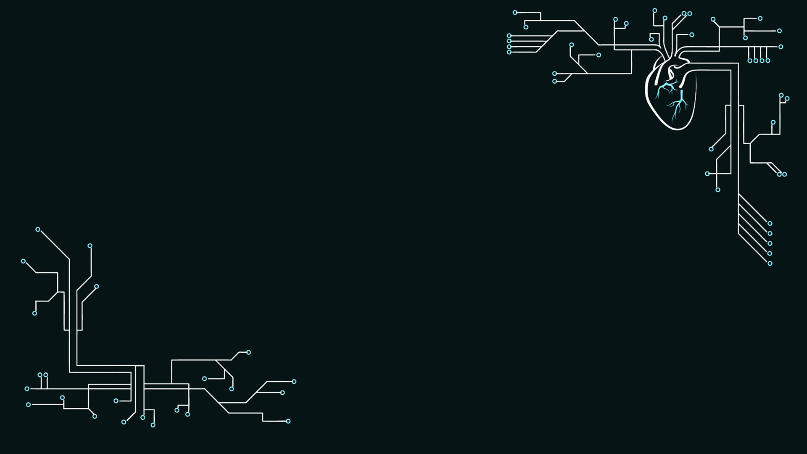
Project Problem
ASU’s return to an in person E2 needs fresh activities to engage the new incoming students. The Escape Room for E2 is without a circuit aspect and requires several implementations to be interacted with. With a large Electrical Engineering school it is almost pivotal there is an implementation involved in E2.

Slide 14
Solution Overview

Slide 15

Requirements & Criteria
Requirements
A working circuit box for jumping wires. The solution must implement the given “key” from the prior puzzle.
Less than 6lbs and within about 2 square feet.
Requires 3 similar solutions to fix onto a locker where the main puzzles are.
Criteria
Resettable (whatever that means for given solution) within 5 minutes
When solved, solution must deliver next step in maze

Slide 16
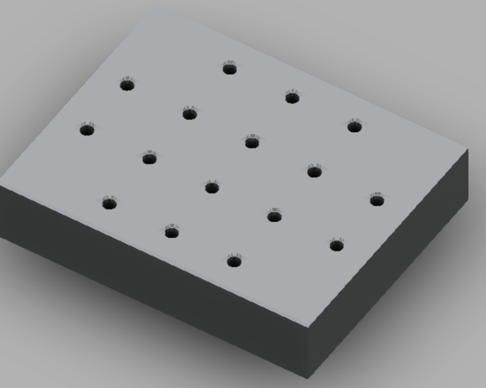

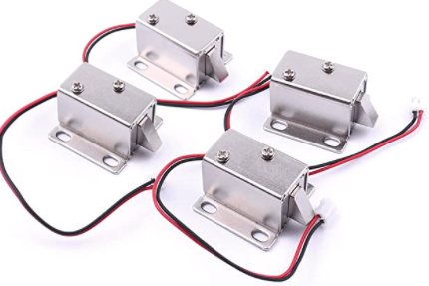
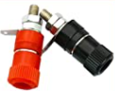
Current Concept
Decision Matrix
Magnetic Lock
Linear Actuator
Solenoid Lock
Winner: Solenoid Lock

Slide 17

Debated Solutions
Hot wire connections
Less able to be altered
“Complex” Circuit solutions
Requires too much base knowledge for participating time frame.
Metal box
Multiple would put unnecessary (potentially critical) stress on locker
Hatch/Hinged Door/Sliding Door

Slide 18

Potential Impact of Solution
E2 is an introduction to collaboration and engineering to come at ASU.
E2 containing parts built from ASU students can encourage a positive loop of ever-improving engineering and E2 camps.

Slide 19
Next steps

Slide 20
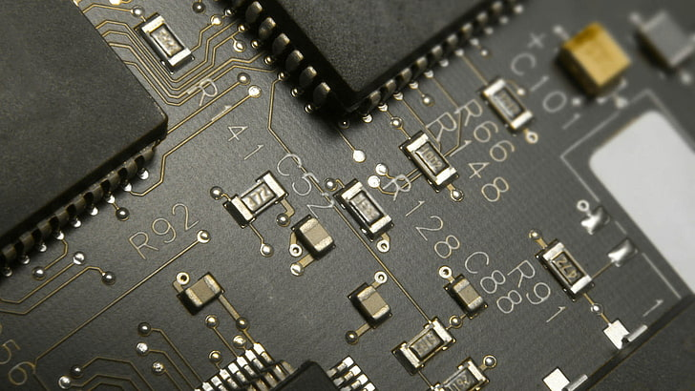
Next Steps
The goal of the semester is a working prototype by December
The budget for the project is under the 500 dollars allotted for EPICS projects. The current prototype would cost around $40 total to produce. The Community Partner’s overall budget falls under the E2 program.
The next step in the process is itemizing parts and getting authorization to order them.
From the parts a mechanical solution can be derived for how to reveal the key to the next part of the activity.

Slide 21

Barriers

Slide 22

PESTLE
Political
Economic
Social
Technological
Legal
Environmental

Slide 23

Challenges
Finding appropriate supplies and parts
Applying PESTLE
Splitting workloads effectively and efficiently
Diverting attention to other potential solutions
(since multiple solutions are desired in the end with slight variations)

Slide 24
Questions

